Slide 1
“Dnyaneshwari Jwellers”
Presenting....
By. Lolage Pranav & Mandan Kshitij

Slide 2
introduction
We Consist Jewellery of small decorative items worn for personal use like rings, neckless, earrings, pedants, bracletes, etc.
Our company “Dnyaneshwari jewellers” Manufacture the gold and silver jewellery and sales to customer. Our company can also make the jewellery on customers chosen design.
In keeping view of jewellery shop database requirement we have developed this project using PHP as backend and HTML,CSS,JS as Frontend.
Our System keeps record in systematic way, which allows us to find any record easily in our database.

Slide 3
Features.
The convenience of online shopping:-
• Saves time and efforts.
• The convenience of shopping at home.
• Wide variety/range of products are available.
• Good discounts / lower prices
1.User Registration and Authentication: Allow users to create accounts, log in securely, and manage their profiles. Registration could be simplified with social media integration.
2.Product Catalog: Showcase a wide range of jewelry products, including rings, necklaces, earrings, bracelets, and more. Each product should have detailed descriptions, high-quality images, and pricing information

Slide 4
Objective
The computerized system was needed because there were following drawbacks in the present manual system.
Keeping a record of all entered information was a very difficult job.
Searching a particular record was hard because it involved in searching all entries which required more time.
Manual system is difficult & time consuming.
Current records can be matched with the past records which improves planning & implementation.
Makes system user friendly.

Slide 5
Why should you choose us ?
We provide 24/7 customer support so you don’t need to worry about your product Booking
Better quality and price to customers !
Keeps upgarding and Advancing our webage user experience !
Customers don’t need to relay on shop !

Slide 6
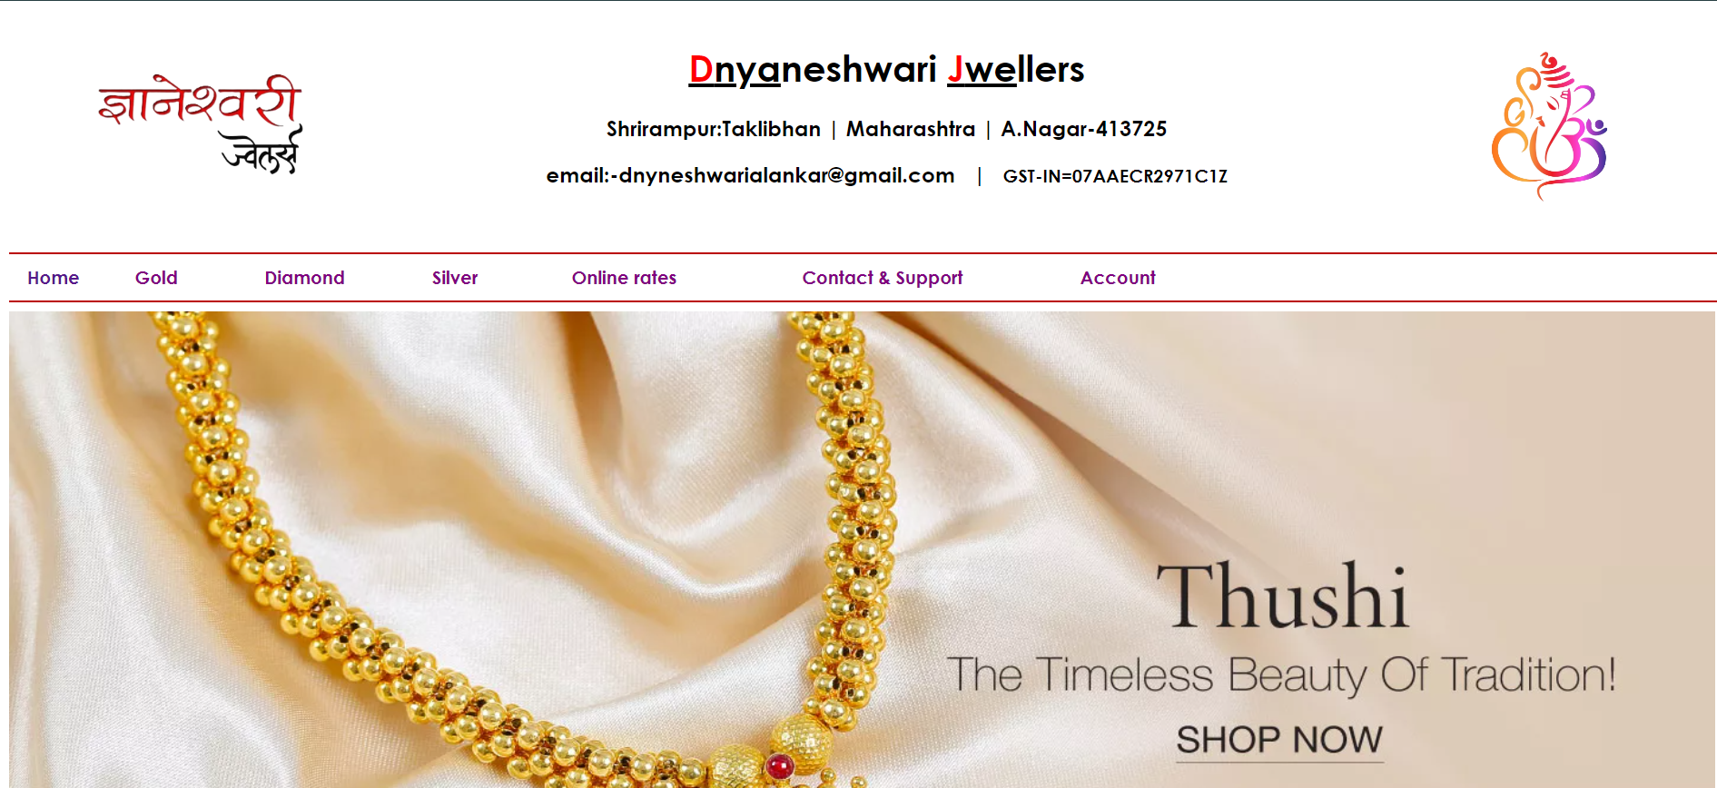
Some ScreenShort..
HomePage

Slide 7
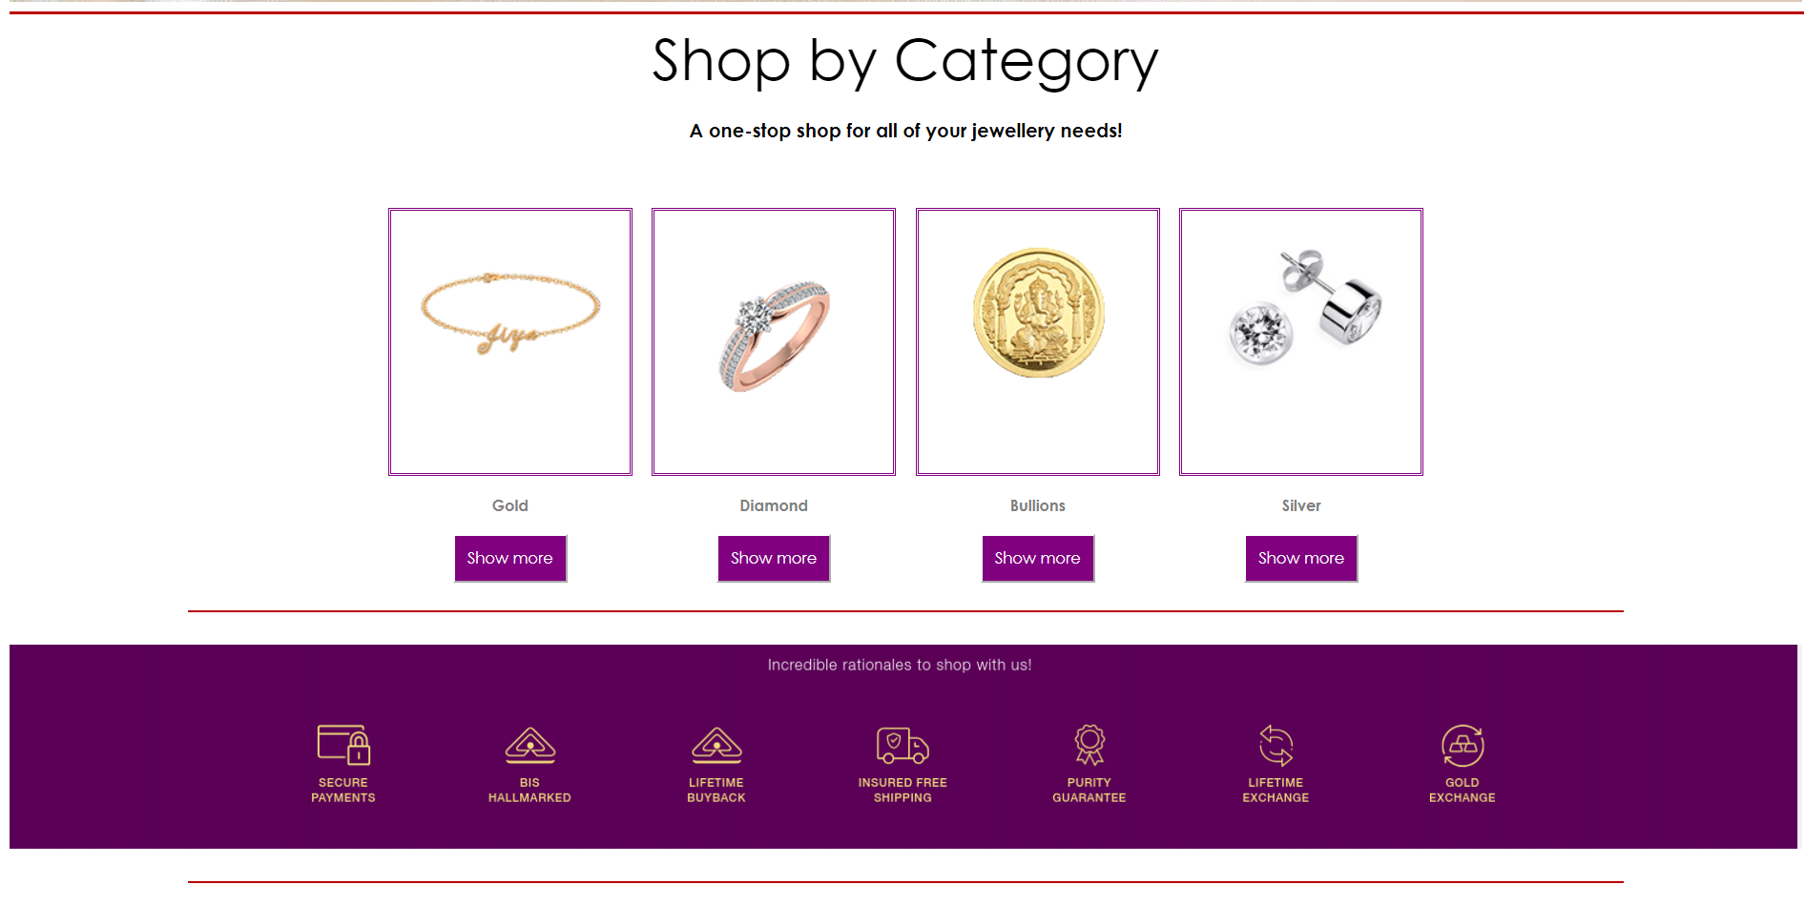
Verieties

Slide 8
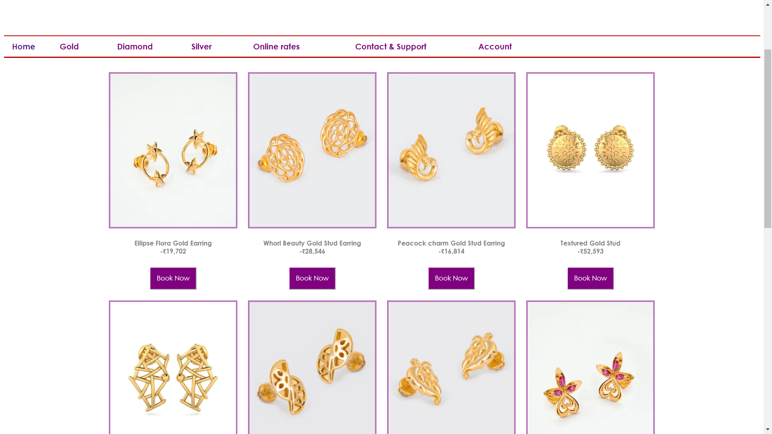
Product overview

Slide 9
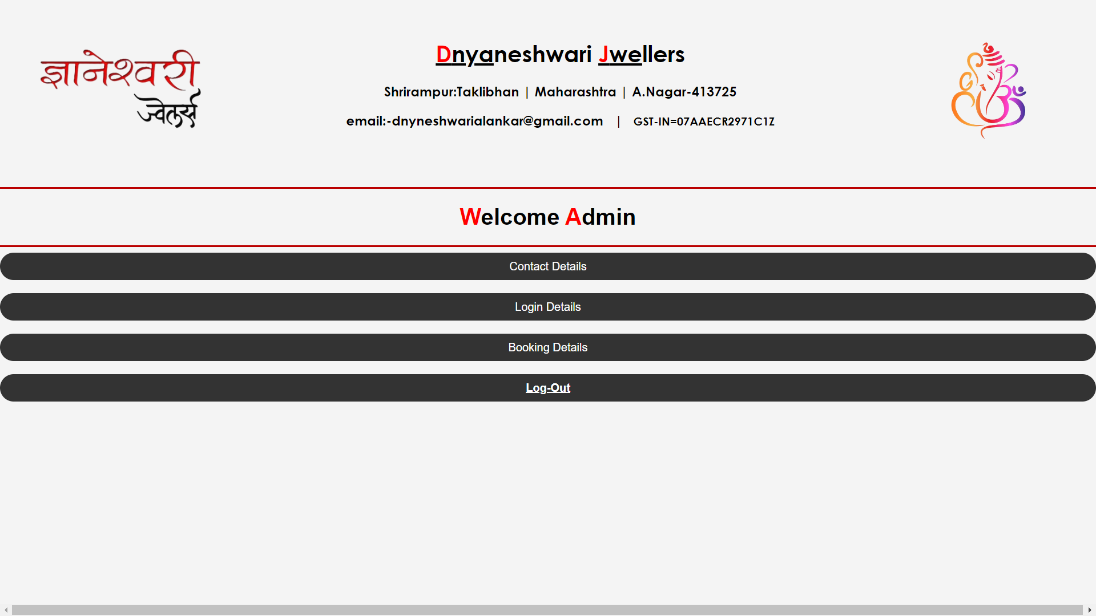
Admin Pannel

Slide 10
Thank You …....

